Slide 1
CS61C: Great Ideas in Computer Architecture (aka Machine Structures)
Lecture 24: Finite State Machines, Operating Systems
Instructors: Lisa Yan, Justin Yokota

Slide 2
Agenda
Finite State Machines
Operating Systems

Slide 3
Class Roadmap
Computer science can be broken down roughly into three categories:
Hardware: How you get rocks to do computations for you
Software: How you get computations to do work for you.
Theory: Use math to determine the limits of what a computer can do
Each category affects what can be done in each other category
Software
Hardware
Theory

Slide 4
Class Roadmap
61A primarily focused on software and how you write a program
61B was also primarily software, but went a bit into theory when discussing some data structures.
70 is primarily about theory and developing the mathematical skill to prove things
61C is mostly about the interaction between software and hardware, but a few pieces end up dabbling in theory
Software
Hardware
Theory

Slide 5
Class Roadmap
Part 1 of this course was mostly in C (software)
Number rep went a bit into theory and how math can influence software
Part 2 moved into RISC-V, which forms the core of how software influences hardware: the hardware is built to implement assembly, which then can be used for software.
Software
Hardware
Theory

Slide 6
Class Roadmap
Part 3 went fully into the hardware side of this course, discussing the exact way that a CPU can be built from simple components
Often the biggest disconnect students face in this class; because hardware has an entirely new perspective, many students get lost here, and many other students find this to be the moment CS "clicks" for them
From Monday, we'll start Part 4 of this course, which delves into performance programming and how existing hardware ends up affecting the way you write software.
Software
Hardware
Theory

Slide 7
Class Roadmap
Today's lecture will go into two largely different computational models:
Finite State Machines, which form a theoretical framework of computation, that is best implemented in hardware
Operating systems, which will let us go from the simple programs we write in class to a full-scale computer (mostly software)
Both will appear infrequently in Part 4, but otherwise won't be explored too much in this class.
Software
Hardware
Theory

Slide 8
Agenda
Finite State Machines
Operating Systems

Slide 9
Finite State Machines (FSMs)
Finite State Machines appear in several formats
CS 70: Markov Chains are FSMs with probabilistic transitions
CS 61B: FSMs used in Project 3 for video game states
CS 172: DFAs and NFAs get explored, along with their connection to regular expressions
In this class, we'll consider a particular type of FSM called a Mealy Machine (from now on, when we say FSM, we specifically refer to this type of FSM)

Slide 10
FSM: Definition
An FSM consists of:
A set of states S
Each state represents all that the machine "remembers": if a machine is in a particular state, then it will "react" to any input in the same manner
The number of states must be finite; we are not allowed to have an infinite-state machine
In the right, S0, S1, and S2 are our states.
S0
S1
S2

Slide 11
FSM: Definition
An FSM consists of:
A set of states S
One of these states is designated as the start state S₀
This represents the state that the machine will start in when beginning computation
Denoted by a blank arrow pointing to one state (in the right, S0 is the start state)
S0
S1
S2

Slide 12
FSM: Definition
An FSM consists of:
A set of states S
A start state S₀ ∈ S
At each clock tick, the FSM will receive an input of one bit. It will then:
Transition from its current state to a new state
Output one bit.
Both the transition and output must depend solely on the input bit and the current state; formally, there is a transition function T: S x {0,1} → S x {0,1}
1/1
0/0
1/0
S0
S1
S2
1/0
0/0
0/0

Slide 13
FSM: Definition
An FSM consists of:
A set of states S
A start state S₀ ∈ S
A transition function T: S x {0,1} → S x {0,1}.
To read the graph on the right: Each arrow represents a transition. The numbers above it signify the input and output of that particular transition.
Ex. The red arrow means that if we are currently in state S0 AND we receive an input of 1, we should move to state S1 and output 0.
1/1
0/0
1/0
S0
S1
S2
1/0
0/0
0/0

Slide 14
FSM: State Transition Diagram
Each state needs exactly two arrows leaving it: one for input 0, and one for input 1
Ex. If we are currently on state S1, then:
If we receive input 1, we'll move to state S2 and output 0
If we receive input 0, we'll move to state S0 and output 0
1/1
0/0
1/0
S0
S1
S2
1/0
0/0
0/0

Slide 15
FSM: Waveform
Let's see what happens when we run this FSM on the below input
1/1
0/0
1/0
S0
S1
S2
1/0
0/0
0/0
Input
0 | 1 | 0 | 1 | 1 | 0 | 1 | 1 | 1 | 0 | 1 | 1 | 1 | 1 | 0 | 1 | 1 | 1 | 1 | 1 | 1 | 0
Output

Slide 16
FSM: Waveform
Let's see what happens when we run this FSM on the below input
1/1
0/0
1/0
S0
S1
S2
1/0
0/0
0/0
Input
0 | 1 | 0 | 1 | 1 | 0 | 1 | 1 | 1 | 0 | 1 | 1 | 1 | 1 | 0 | 1 | 1 | 1 | 1 | 1 | 1 | 0
Output

Slide 17
FSM: Waveform
Let's see what happens when we run this FSM on the below input
1/1
0/0
1/0
S0
S1
S2
1/0
0/0
0/0
Input
0 | 1 | 0 | 1 | 1 | 0 | 1 | 1 | 1 | 0 | 1 | 1 | 1 | 1 | 0 | 1 | 1 | 1 | 1 | 1 | 1 | 0
Output
0

Slide 18
FSM: Waveform
Let's see what happens when we run this FSM on the below input
1/1
0/0
1/0
S0
S1
S2
1/0
0/0
0/0
Input
0 | 1 | 0 | 1 | 1 | 0 | 1 | 1 | 1 | 0 | 1 | 1 | 1 | 1 | 0 | 1 | 1 | 1 | 1 | 1 | 1 | 0
Output
0 | 0

Slide 19
FSM: Waveform
Let's see what happens when we run this FSM on the below input
1/1
0/0
1/0
S0
S1
S2
1/0
0/0
0/0
Input
0 | 1 | 0 | 1 | 1 | 0 | 1 | 1 | 1 | 0 | 1 | 1 | 1 | 1 | 0 | 1 | 1 | 1 | 1 | 1 | 1 | 0
Output
0 | 0 | 0

Slide 20
FSM: Waveform
Let's see what happens when we run this FSM on the below input
1/1
0/0
1/0
S0
S1
S2
1/0
0/0
0/0
Input
0 | 1 | 0 | 1 | 1 | 0 | 1 | 1 | 1 | 0 | 1 | 1 | 1 | 1 | 0 | 1 | 1 | 1 | 1 | 1 | 1 | 0
Output
0 | 0 | 0 | 0

Slide 21
FSM: Waveform
Let's see what happens when we run this FSM on the below input
1/1
0/0
1/0
S0
S1
S2
1/0
0/0
0/0
Input
0 | 1 | 0 | 1 | 1 | 0 | 1 | 1 | 1 | 0 | 1 | 1 | 1 | 1 | 0 | 1 | 1 | 1 | 1 | 1 | 1 | 0
Output
0 | 0 | 0 | 0 | 0

Slide 22
FSM: Waveform
Let's see what happens when we run this FSM on the below input
1/1
0/0
1/0
S0
S1
S2
1/0
0/0
0/0
Input
0 | 1 | 0 | 1 | 1 | 0 | 1 | 1 | 1 | 0 | 1 | 1 | 1 | 1 | 0 | 1 | 1 | 1 | 1 | 1 | 1 | 0
Output
0 | 0 | 0 | 0 | 0 | 0 | 0 | 0 | 1 | 0 | 0 | 0 | 1 | 0 | 0 | 0 | 0 | 1 | 0 | 0 | 1 | 0

Slide 23
FSM: Waveform
What pattern is this FSM detecting?
e.g. What input causes the output to be 1?
1/1
0/0
1/0
S0
S1
S2
1/0
0/0
0/0
Input
0 | 1 | 0 | 1 | 1 | 0 | 1 | 1 | 1 | 0 | 1 | 1 | 1 | 1 | 0 | 1 | 1 | 1 | 1 | 1 | 1 | 0
Output
0 | 0 | 0 | 0 | 0 | 0 | 0 | 0 | 1 | 0 | 0 | 0 | 1 | 0 | 0 | 0 | 0 | 1 | 0 | 0 | 1 | 0

Slide 24
FSM: Waveform
What pattern is this FSM detecting?
The output bit is 1 for every sequence of 3 consecutive 1s (with the counter resetting after 3 consecutive 1s are seen)
1/1
0/0
1/0
S0
S1
S2
1/0
0/0
0/0
Input
0 | 1 | 0 | 1 | 1 | 0 | 1 | 1 | 1 | 0 | 1 | 1 | 1 | 1 | 0 | 1 | 1 | 1 | 1 | 1 | 1 | 0
Output
0 | 0 | 0 | 0 | 0 | 0 | 0 | 0 | 1 | 0 | 0 | 0 | 1 | 0 | 0 | 0 | 0 | 1 | 0 | 0 | 1 | 0

Slide 25
FSM: Waveform
What pattern is this FSM detecting?
The output bit is 1 for every sequence of 3 consecutive 1s (with the counter resetting after 3 consecutive 1s are seen)
S0: 0 consecutive 1s so far S1: 1 consecutive 1 so far S2: 2 consecutive 1s so far
1/1
0/0
1/0
S0
S1
S2
1/0
0/0
0/0
Input
0 | 1 | 0 | 1 | 1 | 0 | 1 | 1 | 1 | 0 | 1 | 1 | 1 | 1 | 0 | 1 | 1 | 1 | 1 | 1 | 1 | 0
Output
0 | 0 | 0 | 0 | 0 | 0 | 0 | 0 | 1 | 0 | 0 | 0 | 1 | 0 | 0 | 0 | 0 | 1 | 0 | 0 | 1 | 0

Slide 26
Making an FSM based on a problem
Let's say we want an FSM that outputs 1 if the previous two inputs were different (and anything for the first output)
On input 01101001000010, output 01011101100011
To accomplish this, we need to keep track of the previous bit
Notably, that's the only thing we need to "remember"; if we know our last input was 0, then we can tell what to output based on the next input.
Create 2 states: 0 and 1.

Slide 27
Making an FSM based on a problem
Let's say we want an FSM that outputs 1 if the previous two inputs were different (and anything for the first output)
On input 01101001000010, output 01011101100011
If the last input was 0 and the current input is 0:
Stay in state 0
Output 0
0
1

Slide 28
Making an FSM based on a problem
Let's say we want an FSM that outputs 1 if the previous two inputs were different (and anything for the first output)
On input 01101001000010, output 01011101100011
If the last input was 0 and the current input is 1:
Move to state 1
Output 1
0/0
0
1

Slide 29
Making an FSM based on a problem
Let's say we want an FSM that outputs 1 if the previous two inputs were different (and anything for the first output)
On input 01101001000010, output 01011101100011
If the last input was 1 and the current input is 0:
Move to state 0 and output 1
If the last input was 1 and the current input is 1:
Stay in state 1 and output 0
0/0
0
1
1/1

Slide 30
Making an FSM based on a problem
Let's say we want an FSM that outputs 1 if the previous two inputs were different (and anything for the first output)
On input 01101001000010, output 01011101100011
0/0
1/0
0/1
0
1
1/1

Slide 31
Showing that a problem can't be solved by an FSM
Let's say we want an FSM that outputs 1 if there are an equal number of 0s and 1s so far in the input
How many states would we need?
One for when you have equal numbers of 0s and 1s
One for when you have 1 more 1 than 0
…

Slide 32
Showing that a problem can't be solved by an FSM
Let's say we want an FSM that outputs 1 if there are an equal number of 0s and 1s so far in the input
How many states would we need?
Infinitely many states!
We can't have infinitely many states, so NO FSM exists that solves this problem
0/0
0/0
0/0
0/0
0/1
0/0
0/0
0/0
-4
-3
-2
-1
0
1
2
3
4
1/0
1/0
1/0
1/1
1/0
1/0
1/0
1/0

Slide 33
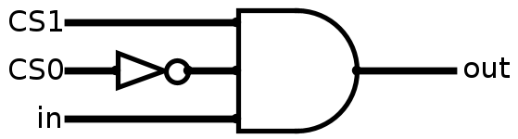
FSM: Transition Function Table
Alternate form of an FSM: a transition table
Two inputs: current state (CS) and input (in)
Two outputs: next state (NS) and output (out)
Each state is labeled with a unique binary number
Using this, it's possible to make a boolean circuit to implement any FSM
CS | in | NS | out
00 | 0 | 00 | 0
00 | 1 | 01 | 0
01 | 0 | 00 | 0
01 | 1 | 10 | 0
10 | 0 | 00 | 0
10 | 1 | 00 | 1
out = (CS1)(!CS0)(in)

Slide 34
FSM: Circuit Format
To implement an FSM in a circuit:
Use a combinational logic block to receive input and current state, and send output and next state
Save the state in a register
Acts as a very small datapath
Similarly, any circuit with state elements can be considered an FSM (by combining all state elements into a single mega-register)
Transition Function
CS
NS
D
Q
Input
Output
clk

Slide 35
Any physical computer is an FSM: CS 172 preview
A CPU is also a circuit with state elements, so it is also an FSM!
Total number of states is <Number of possible PC values> x <Number of possible RegFile states> x <Number of possible DMEM states> = 2³⁴³⁵⁹⁷³⁹³⁹² states assuming 32-bit address space: Number of states is extremely large, but still finite
Corollary: No program can solve the problem of "Does a bitstring have the same number of 1s and 0s"
We can write a program that works for any string we'll see in real life, but it'll fail if we ever have a string with 2³⁴³⁵⁹⁷³⁹³⁹²+1 1s, followed by 2³⁴³⁵⁹⁷³⁹³⁹²+1 0s.
More on this in CS 172

Slide 36
Agenda
Finite State Machines
Operating Systems

Slide 37
Terminology
A program is a sequence of instructions to run (such as an executable)
A process is the actual execution of a program. Each process is a largely separate entity, with its own memory space.
Each process is composed of threads, which are independently running instruction sequences that share most memory.
So far, we've discussed programs that use only 1 thread, on 1 process. However, a single program may spawn multiple processes, each of which use multiple threads.
Multithreaded programs discussed tomorrow.
The datapath we've discussed so far is a CPU core. A single core can run one thread at any given time.
The CPU is composed of multiple cores, which thus allows multiple threads to be run simultaneously.

Slide 38
Overview
So far, all our discussion has been from the perspective of one program.
From the program's perspective, the following are true:
"I am the only program running on the CPU"
"There's only one CPU, one memory, etc. on this system"
"I have a full 2³² bytes of memory to use however I want"
For 64-bit systems, memory is 2⁴⁸ bytes
"ecalls (ex. printf, malloc, scanf) just work"
"All my data's inputs/outputs are in the form of strings, and I get them/output them through stdout/in (or files)."
This isn't actually true anymore
Citation: My computer is currently running a bunch of different processes (well more than the 12 CPUs I have), none of which are just a text-based interface, and none of which are using anywhere close to a TiB of memory.

Slide 39
Computer Startup
Solution: set up one process whose main purpose is to coordinate other processes, and run it on startup. This is known as the Operating System, or OS
How this works:
When you start the computer, the system loads a startup program known as the BIOS (Basic Input/Output System), which is often stored on a special read-only chip
The BIOS does some quick checks to make sure the computer can run, then loads the OS from memory, then transfers control to the OS.
The OS is then responsible for running other programs.
Example OSes: macOS, Windows, Ubuntu, BSD

Slide 40
The OS
The Operating System acts as:
An illusionist
Any program we run doesn't need to know that the OS or other programs exists
Any program we run doesn't need to worry about how syscalls actually work

Slide 41
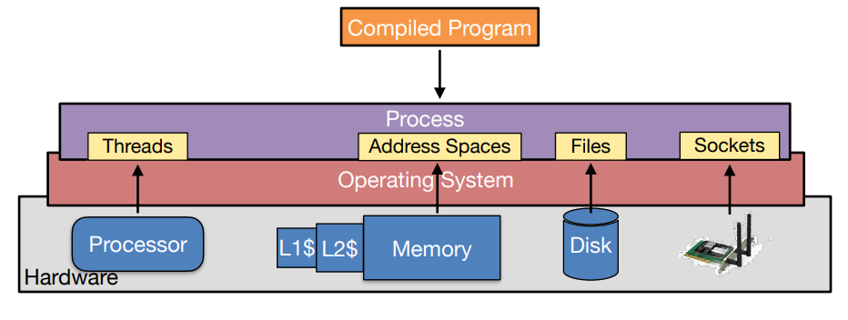
The OS

Slide 42
The OS
The Operating System acts as:
An illusionist
Any program we run doesn't need to know that the OS or other programs exists
Any program we run doesn't need to worry about how syscalls actually work
A conductor
Receive commands from the user and assigns computer resources to tasks

Slide 43
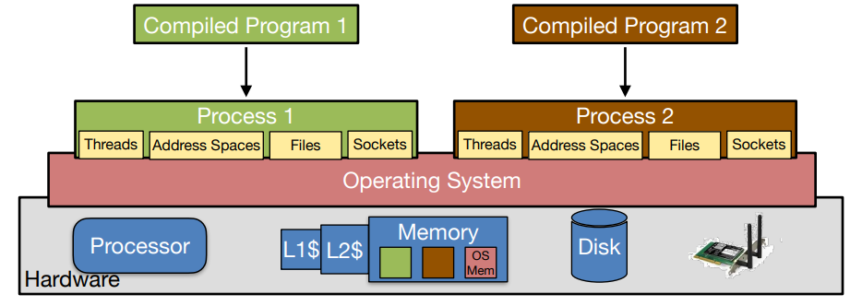
The OS

Slide 44
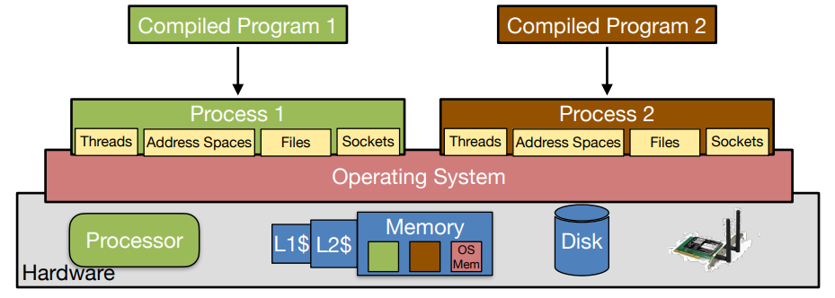
The OS

Slide 45
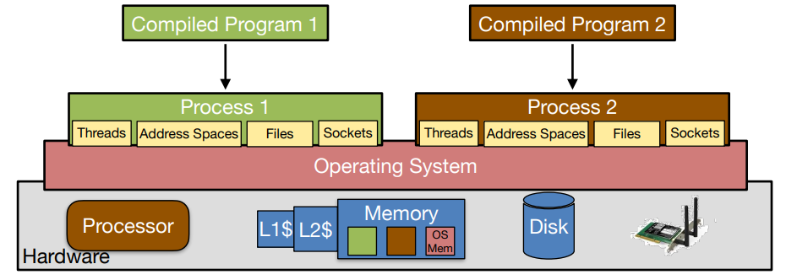
The OS

Slide 46
The OS
The Operating System acts as:
An illusionist
Any program we run doesn't need to know that the OS or other programs exists
Any program we run doesn't need to worry about how syscalls actually work
A conductor
Receive commands from the user and assigns computer resources to tasks
A referee
Keep track of what processes are running, and assign appropriate permissions
If a process exceeds what it's allowed to do or crashes, terminate the process without crashing the entire system.
This includes preventing different programs from affecting each other, and preventing programs from affecting the OS itself.
If a program's using a lot of one resource, make sure other programs also get a turn

Slide 47
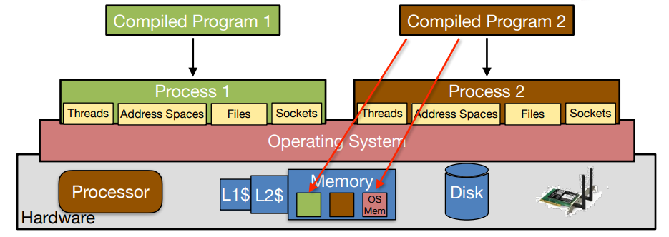
The OS

Slide 48
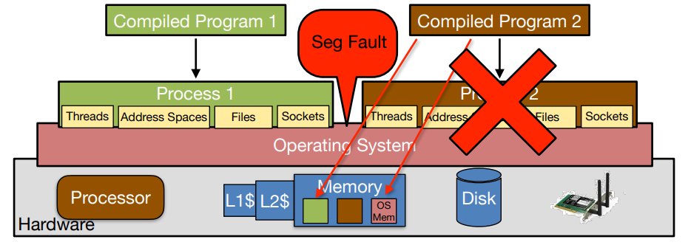
The OS

Slide 49
Dual Mode Operation
Generally, the system provides at least two different "permission levels".
"User Mode", which has limitations on what can be accessed, but is generally "safer" to use
"Kernel Mode", which has more freedom, but which can crash the entire system if it fails
Goal: Restrict "Kernel Mode" to the OS so the user doesn't get to do whatever it wants (helps protect from malicious code)
Goal: Restrict "Kernel Mode" to as few parts of the OS as possible, so if a part of the OS gets compromised, bad things don't happen as easily.
Shell scripts (ex. Git Bash) allow us to communicate directly with the OS (instead of through a program), thus bypassing some of the protections.

Slide 50
The OS
For the purposes of this class, we will consider how the OS allows the use of the following shared resources:
Random Access Memory (RAM)
Covered in greater detail in VM lectures
I/O devices
System Calls
CPU time

Slide 51
Random Access Memory
RAM is a space of memory on the order of ~10 GiB, which can be used by programs to store main memory.
Main idea: OS assigns parts of RAM to processes. When a process tries to access a memory location, the OS takes control for a bit and translates to the corresponding spot in RAM.
Different processes get different parts of RAM, so process A can't access memory of process B even if it tries to (unless there's explicit memory sharing).
The OS also stores its data in RAM, so it needs to make sure that processes don't access memory it doesn't own.

Slide 52
Virtual Memory: Preview
Most processes don't use all their address space.
They mostly use one block of memory in the code segment, another block in the stack, and maybe a few blocks in the heap/data segments.
If we gave each process a full 2⁴⁸ bytes of RAM, we won't be able to fit many processes in our RAM.
Solution: Chop up main memory into "pages" of a few KiB each. When a program tries to access a memory address, have the OS translate the address to its page, and pick up the corresponding data.
Ex. A program may be using 1 page for its code, 1 page for its stack, 4 pages for its heap, etc.
OS as referee: Establish a limit on how many pages a process is allowed to use, and if that limit gets exceeded, don't allow the memory allocation (ex. return NULL on malloc, cause a stack overflow exception).
If a process tries to access a memory location that hasn't been allocated to them, either create a new page for it, or segfault.

Slide 53
I/O devices
I/O constitutes anything that can communicate with your program
Inputs:
Mouse
Keyboard
Microphone
Camera
Outputs:
Speakers
Display
Both:
Long-term Memory (Magnetic Drive or SSD)
Touch Screens
Network/Internet communications
Communication ranges from a few bytes/second (ex. keyboard) to a few hundred MiB/second (ex. SSD)

Slide 54
I/O devices
We could define a separate scheme to handle I/O for all of these
Or we could standardize the interface and let the I/O device handle any complications.
Program's perspective: all I/O gets handled through the file system (ex. fopen, fwrite, fread, fprintf, fclose), though libraries exist to help with interfaces.
Input device's perspective: Receive info from the world, and turn it into a bytestream sent to some fixed memory location
Output device's perspective: Receive a bytestream from some fixed memory location, and translate that into appropriate output
OS's role: Bring data from/to the I/O device to/from the process every once in a while
In theory, simple. In practice, extremely difficult to standardize over 9 orders of magnitude of data rate

Slide 55
System Calls
Functions which can't be directly handled by the program
Examples in C: file operations, print statements, sbrk (which is used by malloc)
Examples in RISC-V: ecalls
Handled by transferring control back to the OS in kernel mode for the syscall
The OS checks if the operation is allowed, and if so, runs the operation for the process.

Slide 56
Sharing CPU: Context Switches
Main idea: In order to handle multiple threads on a single core, we need to have a way to run one thread for a while, then switch to another thread.
Goal: A thread should not "notice" that it was paused, so we need to save its state and restore it later.
Context Switch steps:
OS takes control from the old thread
OS saves the register values for the old thread
OS loads register values for the new thread
OS transfers control to the new thread

Slide 57
Sharing CPU: Context Switches
Context switches tend to be time-consuming, so we generally run them when we already have to wait for other things to happen.
Ex. Main memory accesses can take hundreds or thousands of cycles to run, so while waiting for that, we can context switch and run something else for a while
OS is responsible for deciding when/how often context switches happen, and which threads get access to CPU time.
As such, multiple threads run in effectively random order, and potentially a random interlacing of operations.

Slide 58
CS 162 preview
CS 162 is our Operating Systems class
Goes into much greater detail about each of these components
Projects focus on developing an OS of your own in C (PintOS).
Very big starter code, very difficult to debug
Our Project 4 is another C project, so if you're still shaky with C/GDB/shell commands, now's the time to review!

